Slide 1
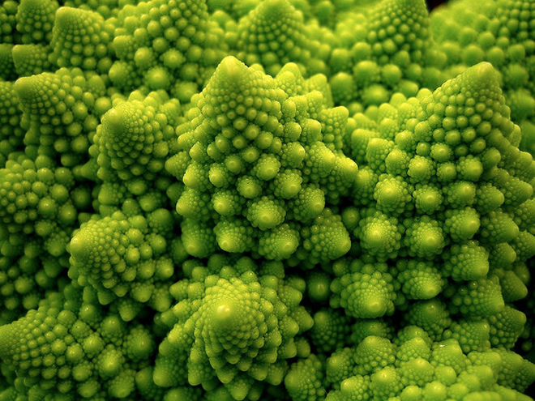
Thinking Recursively
Chris Piech
CS 106B
Lecture 6
Jan 20, 2016

Slide 2
todo
Post readings
Post slides
Rewatch Martys intro

Slide 3

Socrative.com
Room: CS106BWIN16

Slide 4
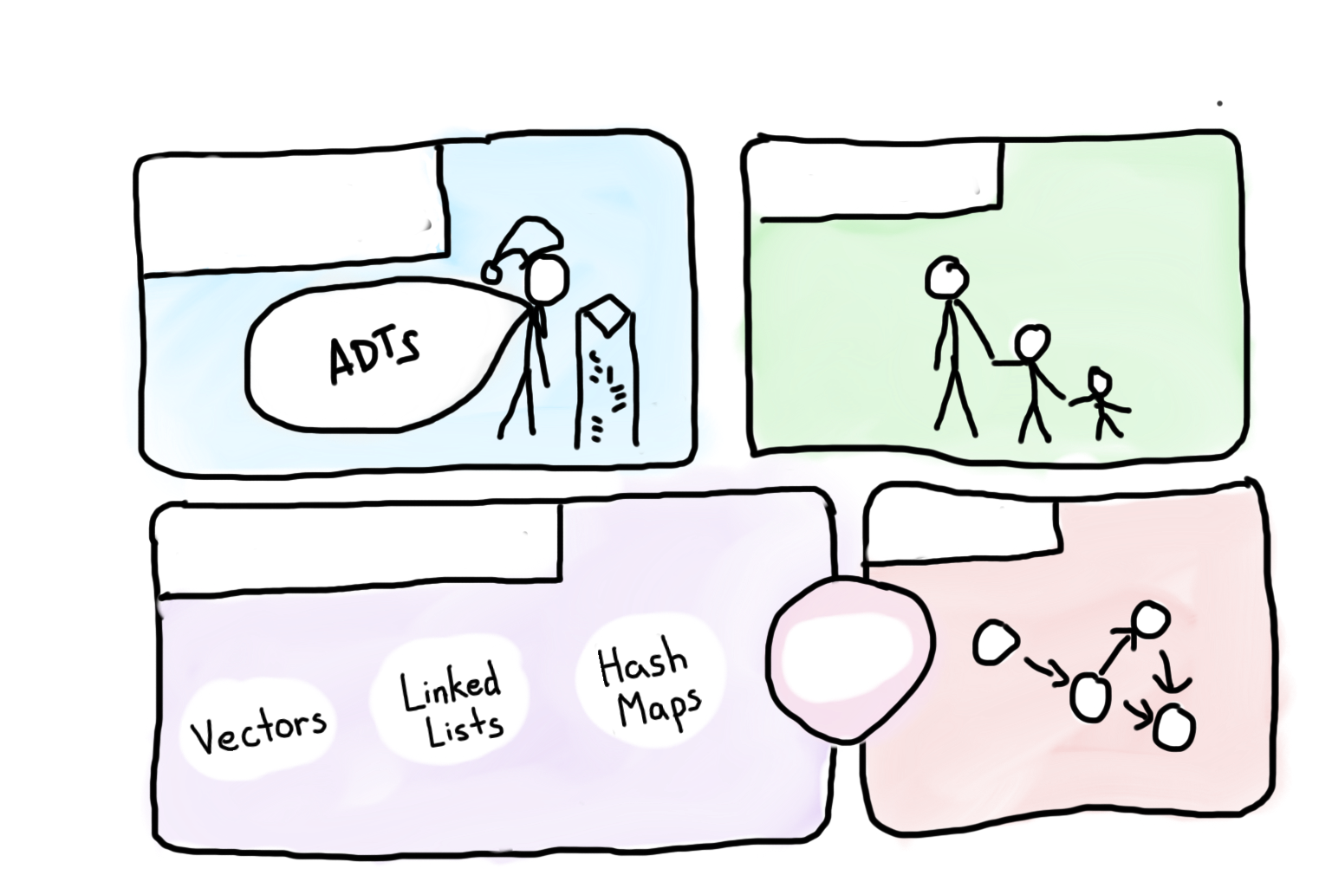

Course Syllabus
Intro to Abstractions
Recursion
Graphs
Under the Hood
Trees
You are here

Slide 5
Towers of Hanoi
A
B
C

Slide 6
Towers of Hanoi
Move this tower...
A
B
C

Slide 7
Towers of Hanoi
Move this tower...
...to this spindle.
A
B
C

Slide 8
Towers of Hanoi
Move this tower...
...to this spindle.
A
B
C

Slide 9
Towers of Hanoi
A
B
C

Slide 10
Towers of Hanoi
A
B
C

Slide 11
Towers of Hanoi
A
B
C

Slide 12
Towers of Hanoi
A
B
C

Slide 13


Slide 14
By the end of today we will write code
that solves this problem

Slide 15

We’ve Gotten Ahead of Ourselves
Source: The Hobbit

Slide 16
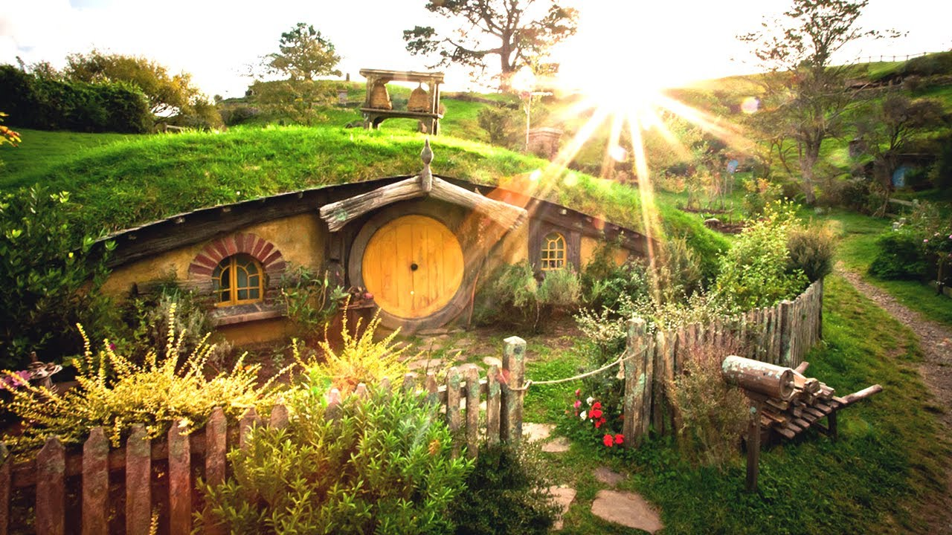
Start at the Beginning
Source: The Hobbit

Slide 17

Today’s Goal
Be able to think about problems recursively

Slide 18

Today’s Route
Wednesday
Hanoi
Many
Examples
Powers
Intuition
Recursion River

Slide 19

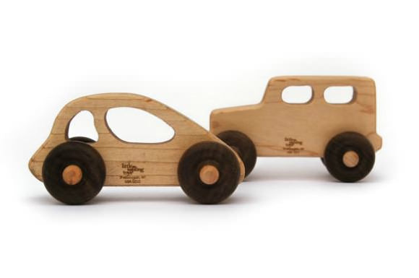
Pedagogy
Start Simple
Build Complexity

Slide 20
Recursion
Solving problems using functions that
call themselves.

Slide 21
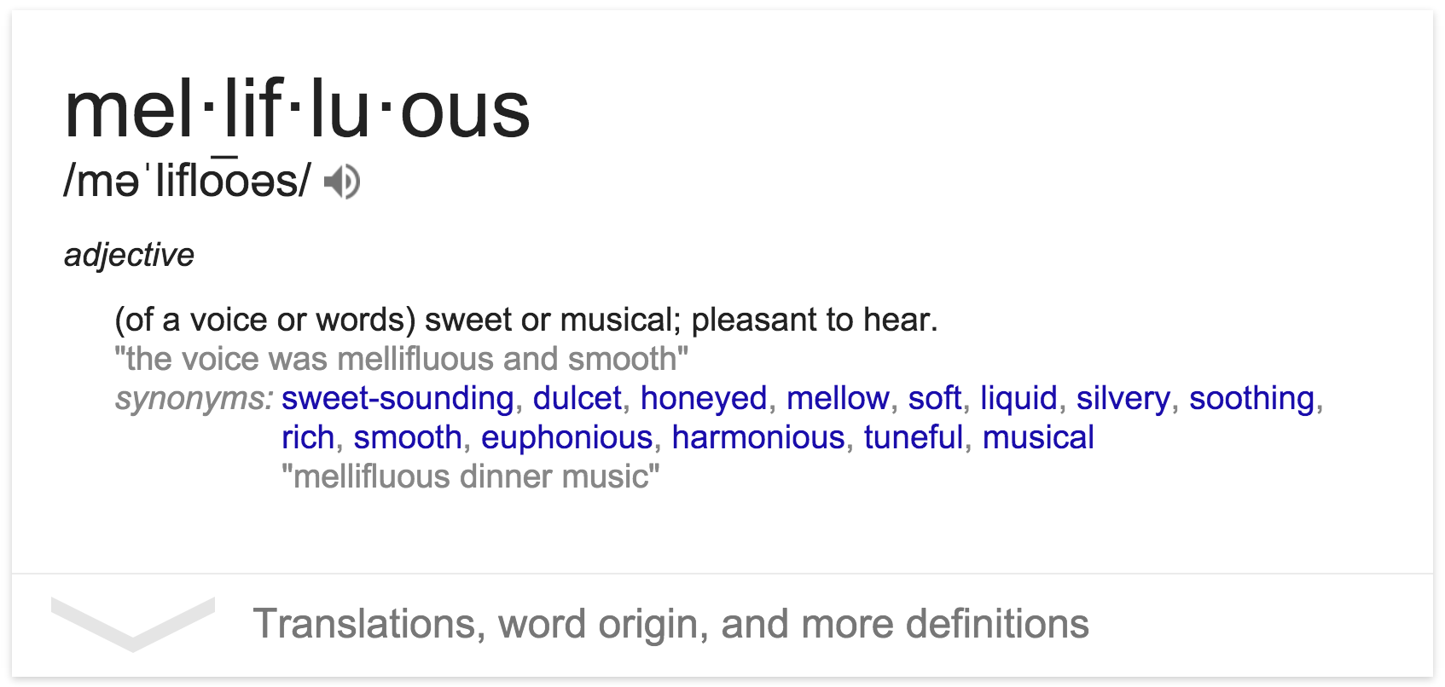
Understanding a Definition

Slide 22
How Many Students in Col?
How many students total are directly behind you in your "column" of the classroom?

Slide 23
How Many Students in Col?
How many students total are directly behind you in your "column" of the classroom?
You can see only the people right next to you. So you can't just look back and count.
But you are allowed to ask questions of the person next to you.
How can we solve this problem (recursively )

Slide 25
How Many Students in Col?
int numStudentsBehind(Student curr) {
if(lastInRow(curr)) {
return 0;
} else {
Student next = curr.getBehind();
return numStudentsBehind(next) + 1;
}
}

Slide 26
Anatomy of Recursion
int numStudentsBehind(Student curr) {
if(lastInRow(curr)) {
return 0;
} else {
Student next = curr.getBehind();
return numStudentsBehind(next) + 1;
}
}

Slide 27
Base Case
int numStudentsBehind(Student curr) {
if(lastInRow(curr)) {
return 0;
} else {
Student next = curr.getBehind();
return numStudentsBehind(next) + 1;
}
}

Slide 28
Recursive Case
int numStudentsBehind(Student curr) {
if(lastInRow(curr)) {
return 0;
} else {
Student next = curr.getBehind();
return numStudentsBehind(next) + 1;
}
}

Slide 29
Recursive Call
int numStudentsBehind(Student curr) {
if(lastInRow(curr)) {
return 0;
} else {
Student next = curr.getBehind();
return numStudentsBehind(next) + 1;
}
}

Slide 30
Recursive Call
int numStudentsBehind(Student curr) {
if(lastInRow(curr)) {
return 0;
} else {
Student next = curr.getBehind();
return numStudentsBehind(next) + 1;
}
}
Progress towards the base case

Slide 31
Three Musts of Recursion
Your code must have a case for all valid inputs.
You must have a base case (makes no recursive calls).
When you make a recursive call it should be to a simpler instance (forward progress towards base case)

Slide 32
Today’s Route
Wednesday
Hanoi
Many
Examples
Powers
Intuition
Recursion River

Slide 33
Recursive Insight
x⁰ = 1
x^{y} = x × x^{(y-1)}

Slide 34
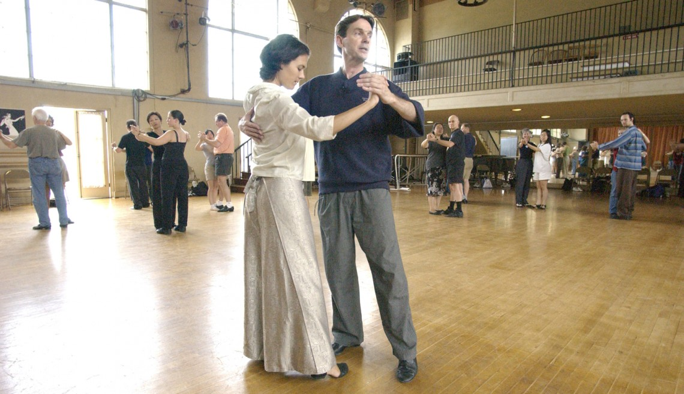

Slide 35
The Call Stack
Each previous call waits for the next call to finish.
cout << power(5, 3) << endl;
// first call: 5 3
int power(int base, int exp) {
if (exp == 1) {
return base;
} else {
return base * power(base, exp - 1);
}
}
// second call: 5 2
int power(int base, int exp) {
if (exp == 1) {
return base;
} else {
return base * power(base, exp - 1);
}
}
// third call: 5 1
int power(int base, int exp) {
if (exp == 1) {
return base; // 5
} else {
return base * power(base, exp - 1);
}
}

Slide 36
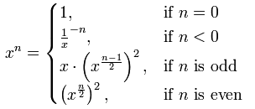
Even Cooler Recursive Insight

Slide 37
Today’s Route
Wednesday
Hanoi
Many
Examples
Powers
Intuition
Recursion River

Slide 38
What Does This Code Do?
A: 5
int mystery(int n) {
if(n < 10) {
return n;
} else {
int toAdd = n % 10;
int theRest = mystery(n / 10);
return theRest + toAdd;
}
}
B: 6
C: 7
D: 8
What is the result of mystery(123)?
// second call: 5 2
int power(int base, int exp) {
if (exp == 1) {
return base;
} else {
return base * power(base, exp - 1);
}
}
// third call: 5 1
int power(int base, int exp) {
if (exp == 1) {
return base; // 5
} else {
return base * power(base, exp - 1);
}

Slide 39
What Does This Code Do?
A: 5
int mystery(int n) {
if(n < 10) {
return n;
} else {
int toAdd = n % 10;
int theRest = mystery(n / 10);
return theRest + toAdd;
}
}
// first call: 123
int mystery(int n) {
if (n < 10) {
return n;
} else {
return (n % 10) + mystery(n / 10);
}
}
B: 6
C: 7
3
D: 8
What is the result of mystery(123)?
// second call: 5 2
int power(int base, int exp) {
if (exp == 1) {
return base;
} else {
return base * power(base, exp - 1);
}
}
// third call: 5 1
int power(int base, int exp) {
if (exp == 1) {
return base; // 5
} else {
return base * power(base, exp - 1);
}

Slide 40
What Does This Code Do?
A: 5
int mystery(int n) {
if(n < 10) {
return n;
} else {
int toAdd = n % 10;
int theRest = mystery(n / 10);
return theRest + toAdd;
}
}
// first call: 123
int mystery(int n) {
if (n < 10) {
return n;
} else {
return (n % 10) + mystery(n / 10);
}
}
B: 6
// second call: 12
int mystery(int n) {
if (n < 10) {
return n;
} else {
return (n % 10) + mystery(n / 10);
}
}
C: 7
3
2
D: 8
What is the result of mystery(123)?
// second call: 5 2
int power(int base, int exp) {
if (exp == 1) {
return base;
} else {
return base * power(base, exp - 1);
}
}
// third call: 5 1
int power(int base, int exp) {
if (exp == 1) {
return base; // 5
} else {
return base * power(base, exp - 1);
}

Slide 41
What Does This Code Do?
A: 5
int mystery(int n) {
if(n < 10) {
return n;
} else {
int toAdd = n % 10;
int theRest = mystery(n / 10);
return theRest + toAdd;
}
}
// first call: 123
int mystery(int n) {
if (n < 10) {
return n;
} else {
return (n % 10) + mystery(n / 10);
}
}
B: 6
// second call: 12
int mystery(int n) {
if (n < 10) {
return n;
} else {
return (n % 10) + mystery(n / 10);
}
}
C: 7
3
// third call: 1
int mystery(int n) {
if (n < 10) {
return n;
} else {
return (n % 10) + mystery(n / 10);
}
}
D: 8
2
1
What is the result of mystery(123)?
// second call: 5 2
int power(int base, int exp) {
if (exp == 1) {
return base;
} else {
return base * power(base, exp - 1);
}
}
// third call: 5 1
int power(int base, int exp) {
if (exp == 1) {
return base; // 5
} else {
return base * power(base, exp - 1);
}

Slide 42
What Does This Code Do?
A: 5
int mystery(int n) {
if(n < 10) {
return n;
} else {
int toAdd = n % 10;
int theRest = mystery(n / 10);
return theRest + toAdd;
}
}
// first call: 123
int mystery(int n) {
if (n < 10) {
return n;
} else {
return (n % 10) + mystery(n / 10);
}
}
B: 6
// second call: 12
int mystery(int n) {
if (n < 10) {
return n;
} else {
return (n % 10) + mystery(n / 10);
}
}
C: 7
3
2
D: 8
1
What is the result of mystery(123)?
// second call: 5 2
int power(int base, int exp) {
if (exp == 1) {
return base;
} else {
return base * power(base, exp - 1);
}
}
// third call: 5 1
int power(int base, int exp) {
if (exp == 1) {
return base; // 5
} else {
return base * power(base, exp - 1);
}

Slide 43
What Does This Code Do?
A: 5
int mystery(int n) {
if(n < 10) {
return n;
} else {
int toAdd = n % 10;
int theRest = mystery(n / 10);
return theRest + toAdd;
}
}
// first call: 123
int mystery(int n) {
if (n < 10) {
return n;
} else {
return (n % 10) + mystery(n / 10);
}
}
B: 6
C: 7
3
3
D: 8
What is the result of mystery(123)?
// second call: 5 2
int power(int base, int exp) {
if (exp == 1) {
return base;
} else {
return base * power(base, exp - 1);
}
}
// third call: 5 1
int power(int base, int exp) {
if (exp == 1) {
return base; // 5
} else {
return base * power(base, exp - 1);
}

Slide 44
Is Palindrome
Write a recursive function isPalindrome(string s) accepts a string and returns true if it reads the same forwards as backwards.
isPalindrome("madam") → true
isPalindrome("racecar") → true
isPalindrome("step on no pets") → true
isPalindrome("able was I ere I saw elba") → true
isPalindrome("Q") → true
isPalindrome("Java") → false
isPalindrome("rotater") → false
isPalindrome("byebye") → false
isPalindrome("notion") → false
What is a good base case?What
What is a good base case?

Slide 45
Is Palendrome
// Returns true if the given string reads the same
// forwards as backwards.
// Trivially true for empty or 1-letter strings.
bool isPalindrome(string s) {
if (s.length() < 2) { // base case
return true;
} else { // recursive case
if (s[0] != s[s.length() - 1]) {
return false;
}
string middle = s.substr(1, s.length() - 2);
return isPalindrome(middle);
}
}

Slide 47
Hailstone
Print the sequences of numbers that you take to get from N until 1, using the Hailstone production rules:
If n == 1, you are done.
If n is odd your next number is 3*n + 1.
If n is even your next number is n / 2.

Slide 48
Hailstone
// Couts the sequence of numbers from n to one
// produced by the Hailstone (aka Collatz)
// procedure
void hailstone(int n) {
cout << n << endl;
if(n == 1) {
return;
} else {
if(n % 2 == 0) {
// n is even so we repeat with n/2 hailstone(n / 2);
} else {
// n is odd so we repeat with 3 * n + 1 hailstone(3 * n + 1);
}
}
}

Slide 49
Are The Recursive Calls Simpler?
// Couts the sequence of numbers from n to one
// produced by the Hailstone (aka Collatz)
// procedure
void hailstone(int n) {
cout << n << endl;
if(n == 1) {
return;
} else {
if(n % 2 == 0) {
// n is even so we repeat with n/2 hailstone(n / 2);
} else {
// n is odd so we repeat with 3 * n + 1 hailstone(3 * n + 1);
}
}
}
When you make a recursive call it should be to a simpler instance (forward progress towards base case)
Well that seems to be true…

Slide 50
Works for numbers up to 5×10¹⁸

Slide 51
Reward for proof

Slide 53
$1,400

Slide 54
And Here We Are

Slide 55
Today’s Route
Wednesday
Hanoi
Many
Examples
Powers
Intuition
Recursion River

Slide 57
Tower of Hanoi Insight
A
B
C
This disk...
...needs to get over here.

Slide 58
Tower of Hanoi Insight
A
B
C
This disk...
...needs to get over here.

Slide 59
Tower of Hanoi Insight
A
B
C
This disk...
...needs to get over here.

Slide 60
Tower of Hanoi Insight
A
B
C

Slide 62
Tower of Hanoi Insight
A
B
C
This disk...
...needs to get over here.

Slide 63
Tower of Hanoi Insight
A
B
C
This disk...
...needs to get over here.

Slide 64
Tower of Hanoi Insight
A
B
C
This disk...
...needs to get over here.

Slide 65
Tower of Hanoi Insight
A
B
C
This disk...
...needs to get over here.

Slide 66
Base Case
We need to find a very simple case that we can solve directly in order for the recursion to work.
If the tower has size one, we can just move that single disk from the source to the destination.

Slide 67
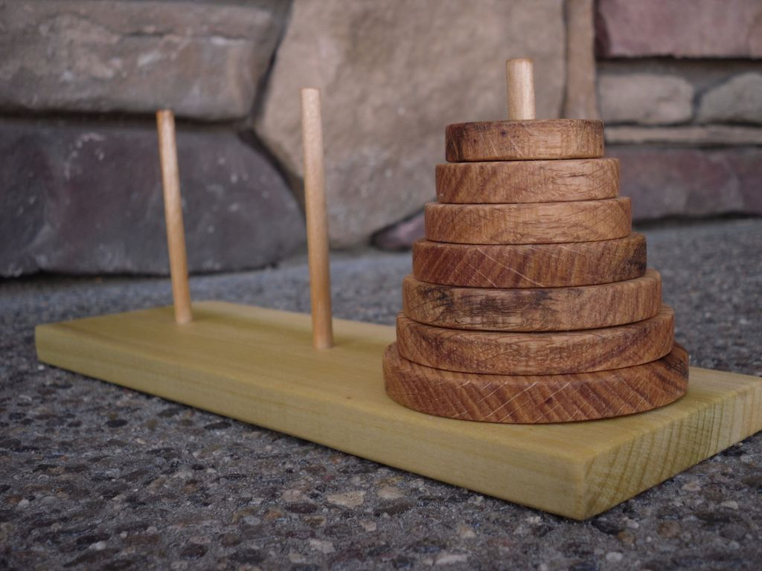

Slide 68
int main() {
moveTower(3, 'a', 'c', 'b');
}
A
A
B
C

Slide 69
int main() {
moveTower(3, 'a', 'c', 'b');
}
A
A
B
C

Slide 70
int main() {
moveTower(3, 'a', 'b', 'c');
}
void moveTower(int n, char from, char to, char temp) {
if (n == 1) {
moveSingleDisk(from, to);
} else {
moveTower(n – 1, from, temp, to);
moveSingleDisk(from, to);
moveTower(n – 1, temp, to, from);
}
}
n
3
from
a
to
c
temp
b
A
A
B
C

Slide 71
int main() {
moveTower(3, 'a', 'b', 'c');
}
void moveTower(int n, char from, char to, char temp) {
if (n == 1) {
moveSingleDisk(from, to);
} else {
moveTower(n – 1, from, temp, to);
moveSingleDisk(from, to);
moveTower(n – 1, temp, to, from);
}
}
n
3
from
a
to
c
temp
b
A
A
B
C

Slide 72
int main() {
moveTower(3, 'a', 'b', 'c');
}
void moveTower(int n, char from, char to, char temp) {
if (n == 1) {
moveSingleDisk(from, to);
} else {
moveTower(n – 1, from, temp, to);
moveSingleDisk(from, to);
moveTower(n – 1, temp, to, from);
}
}
n
3
from
a
to
c
temp
b
A
A
B
C

Slide 73
int main() {
moveTower(3, 'a', 'b', 'c');
}
void moveTower(int n, char from, char to, char temp) {
if (n == 1) {
moveSingleDisk(from, to);
} else {
moveTower(n – 1, from, temp, to);
moveSingleDisk(from, to);
moveTower(n – 1, temp, to, from);
}
}
n
3
from
a
to
c
temp
b
A
A
B
C

Slide 74
int main() {
moveTower(3, 'a', 'b', 'c');
}
void moveTower(int n, char from, char to, char temp) {
if (n == 1) {
moveSingleDisk(from, to);
} else {
moveTower(n – 1, from, temp, to);
moveSingleDisk(from, to);
moveTower(n – 1, temp, to, from);
}
}
void moveTower(int n, char from, char to, char temp) {
if (n == 1) {
moveSingleDisk(from, to);
} else {
moveTower(n – 1, from, temp, to);
moveSingleDisk(from, to);
moveTower(n – 1, temp, to, from);
}
}
n
3
from
a
to
b
temp
c
n
2
from
a
to
b
temp
c
A
A
B
C

Slide 75
int main() {
moveTower(3, 'a', 'b', 'c');
}
void moveTower(int n, char from, char to, char temp) {
if (n == 1) {
moveSingleDisk(from, to);
} else {
moveTower(n – 1, from, temp, to);
moveSingleDisk(from, to);
moveTower(n – 1, temp, to, from);
}
}
void moveTower(int n, char from, char to, char temp) {
if (n == 1) {
moveSingleDisk(from, to);
} else {
moveTower(n – 1, from, temp, to);
moveSingleDisk(from, to);
moveTower(n – 1, temp, to, from);
}
}
n
3
from
a
to
b
temp
c
n
2
from
a
to
b
temp
c
A
A
B
C

Slide 76
int main() {
moveTower(3, 'a', 'b', 'c');
}
void moveTower(int n, char from, char to, char temp) {
if (n == 1) {
moveSingleDisk(from, to);
} else {
moveTower(n – 1, from, temp, to);
moveSingleDisk(from, to);
moveTower(n – 1, temp, to, from);
}
}
void moveTower(int n, char from, char to, char temp) {
if (n == 1) {
moveSingleDisk(from, to);
} else {
moveTower(n – 1, from, temp, to);
moveSingleDisk(from, to);
moveTower(n – 1, temp, to, from);
}
}
n
3
from
a
to
b
temp
c
n
2
from
a
to
b
temp
c
A
A
B
C

Slide 77
int main() {
moveTower(3, 'a', 'b', 'c');
}
void moveTower(int n, char from, char to, char temp) {
if (n == 1) {
moveSingleDisk(from, to);
} else {
moveTower(n – 1, from, temp, to);
moveSingleDisk(from, to);
moveTower(n – 1, temp, to, from);
}
}
void moveTower(int n, char from, char to, char temp) {
if (n == 1) {
moveSingleDisk(from, to);
} else {
moveTower(n – 1, from, temp, to);
moveSingleDisk(from, to);
moveTower(n – 1, temp, to, from);
}
}
n
3
from
a
to
b
temp
c
n
2
from
a
to
b
temp
c
A
A
B
C

Slide 78
int main() {
moveTower(3, 'a', 'b', 'c');
}
void moveTower(int n, char from, char to, char temp) {
if (n == 1) {
moveSingleDisk(from, to);
} else {
moveTower(n – 1, from, temp, to);
moveSingleDisk(from, to);
moveTower(n – 1, temp, to, from);
}
}
void moveTower(int n, char from, char to, char temp) {
if (n == 1) {
moveSingleDisk(from, to);
} else {
moveTower(n – 1, from, temp, to);
moveSingleDisk(from, to);
moveTower(n – 1, temp, to, from);
}
}
void moveTower(int n, char from, char to, char temp) {
if (n == 1) {
moveSingleDisk(from, to);
} else {
moveTower(n – 1, from, temp, to);
moveSingleDisk(from, to);
moveTower(n – 1, temp, to, from);
}
}
n
3
from
a
to
b
temp
c
n
2
from
a
to
c
temp
b
n
1
from
a
to
c
temp
b
A
A
B
C

Slide 79
int main() {
moveTower(3, 'a', 'b', 'c');
}
void moveTower(int n, char from, char to, char temp) {
if (n == 1) {
moveSingleDisk(from, to);
} else {
moveTower(n – 1, from, temp, to);
moveSingleDisk(from, to);
moveTower(n – 1, temp, to, from);
}
}
void moveTower(int n, char from, char to, char temp) {
if (n == 1) {
moveSingleDisk(from, to);
} else {
moveTower(n – 1, from, temp, to);
moveSingleDisk(from, to);
moveTower(n – 1, temp, to, from);
}
}
void moveTower(int n, char from, char to, char temp) {
if (n == 1) {
moveSingleDisk(from, to);
} else {
moveTower(n – 1, from, temp, to);
moveSingleDisk(from, to);
moveTower(n – 1, temp, to, from);
}
}
n
3
from
a
to
b
temp
c
n
2
from
a
to
c
temp
b
n
1
from
a
to
c
temp
b
A
A
B
C

Slide 80
int main() {
moveTower(3, 'a', 'b', 'c');
}
void moveTower(int n, char from, char to, char temp) {
if (n == 1) {
moveSingleDisk(from, to);
} else {
moveTower(n – 1, from, temp, to);
moveSingleDisk(from, to);
moveTower(n – 1, temp, to, from);
}
}
void moveTower(int n, char from, char to, char temp) {
if (n == 1) {
moveSingleDisk(from, to);
} else {
moveTower(n – 1, from, temp, to);
moveSingleDisk(from, to);
moveTower(n – 1, temp, to, from);
}
}
void moveTower(int n, char from, char to, char temp) {
if (n == 1) {
moveSingleDisk(from, to);
} else {
moveTower(n – 1, from, temp, to);
moveSingleDisk(from, to);
moveTower(n – 1, temp, to, from);
}
}
n
3
from
a
to
b
temp
c
n
2
from
a
to
c
temp
b
n
1
from
a
to
c
temp
b
A
A
B
C

Slide 81
int main() {
moveTower(3, 'a', 'b', 'c');
}
void moveTower(int n, char from, char to, char temp) {
if (n == 1) {
moveSingleDisk(from, to);
} else {
moveTower(n – 1, from, temp, to);
moveSingleDisk(from, to);
moveTower(n – 1, temp, to, from);
}
}
void moveTower(int n, char from, char to, char temp) {
if (n == 1) {
moveSingleDisk(from, to);
} else {
moveTower(n – 1, from, temp, to);
moveSingleDisk(from, to);
moveTower(n – 1, temp, to, from);
}
}
void moveTower(int n, char from, char to, char temp) {
if (n == 1) {
moveSingleDisk(from, to);
} else {
moveTower(n – 1, from, temp, to);
moveSingleDisk(from, to);
moveTower(n – 1, temp, to, from);
}
}
n
3
from
a
to
b
temp
c
n
2
from
a
to
c
temp
b
n
1
from
a
to
c
temp
b
A
A
B
C

Slide 82
int main() {
moveTower(3, 'a', 'b', 'c');
}
void moveTower(int n, char from, char to, char temp) {
if (n == 1) {
moveSingleDisk(from, to);
} else {
moveTower(n – 1, from, temp, to);
moveSingleDisk(from, to);
moveTower(n – 1, temp, to, from);
}
}
void moveTower(int n, char from, char to, char temp) {
if (n == 1) {
moveSingleDisk(from, to);
} else {
moveTower(n – 1, from, temp, to);
moveSingleDisk(from, to);
moveTower(n – 1, temp, to, from);
}
}
n
3
from
a
to
b
temp
c
n
2
from
a
to
b
temp
c
A
A
B
C

Slide 83
int main() {
moveTower(3, 'a', 'b', 'c');
}
void moveTower(int n, char from, char to, char temp) {
if (n == 1) {
moveSingleDisk(from, to);
} else {
moveTower(n – 1, from, temp, to);
moveSingleDisk(from, to);
moveTower(n – 1, temp, to, from);
}
}
void moveTower(int n, char from, char to, char temp) {
if (n == 1) {
moveSingleDisk(from, to);
} else {
moveTower(n – 1, from, temp, to);
moveSingleDisk(from, to);
moveTower(n – 1, temp, to, from);
}
}
n
3
from
a
to
b
temp
c
n
2
from
a
to
b
temp
c
A
A
B
C

Slide 84
int main() {
moveTower(3, 'a', 'b', 'c');
}
void moveTower(int n, char from, char to, char temp) {
if (n == 1) {
moveSingleDisk(from, to);
} else {
moveTower(n – 1, from, temp, to);
moveSingleDisk(from, to);
moveTower(n – 1, temp, to, from);
}
}
void moveTower(int n, char from, char to, char temp) {
if (n == 1) {
moveSingleDisk(from, to);
} else {
moveTower(n – 1, from, temp, to);
moveSingleDisk(from, to);
moveTower(n – 1, temp, to, from);
}
}
n
3
from
a
to
b
temp
c
n
2
from
a
to
b
temp
c
A
A
B
C

Slide 85
int main() {
moveTower(3, 'a', 'b', 'c');
}
void moveTower(int n, char from, char to, char temp) {
if (n == 1) {
moveSingleDisk(from, to);
} else {
moveTower(n – 1, from, temp, to);
moveSingleDisk(from, to);
moveTower(n – 1, temp, to, from);
}
}
void moveTower(int n, char from, char to, char temp) {
if (n == 1) {
moveSingleDisk(from, to);
} else {
moveTower(n – 1, from, temp, to);
moveSingleDisk(from, to);
moveTower(n – 1, temp, to, from);
}
}
n
3
from
a
to
b
temp
c
n
2
from
a
to
b
temp
c
A
A
B
C

Slide 86
int main() {
moveTower(3, 'a', 'b', 'c');
}
void moveTower(int n, char from, char to, char temp) {
if (n == 1) {
moveSingleDisk(from, to);
} else {
moveTower(n – 1, from, temp, to);
moveSingleDisk(from, to);
moveTower(n – 1, temp, to, from);
}
}
void moveTower(int n, char from, char to, char temp) {
if (n == 1) {
moveSingleDisk(from, to);
} else {
moveTower(n – 1, from, temp, to);
moveSingleDisk(from, to);
moveTower(n – 1, temp, to, from);
}
}
void moveTower(int n, char from, char to, char temp) {
if (n == 1) {
moveSingleDisk(from, to);
} else {
moveTower(n – 1, from, temp, to);
moveSingleDisk(from, to);
moveTower(n – 1, temp, to, from);
}
}
n
3
from
a
to
b
temp
c
n
2
from
a
to
c
temp
b
n
1
from
c
to
b
temp
a
A
A
B
C

Slide 87
int main() {
moveTower(3, 'a', 'b', 'c');
}
void moveTower(int n, char from, char to, char temp) {
if (n == 1) {
moveSingleDisk(from, to);
} else {
moveTower(n – 1, from, temp, to);
moveSingleDisk(from, to);
moveTower(n – 1, temp, to, from);
}
}
void moveTower(int n, char from, char to, char temp) {
if (n == 1) {
moveSingleDisk(from, to);
} else {
moveTower(n – 1, from, temp, to);
moveSingleDisk(from, to);
moveTower(n – 1, temp, to, from);
}
}
void moveTower(int n, char from, char to, char temp) {
if (n == 1) {
moveSingleDisk(from, to);
} else {
moveTower(n – 1, from, temp, to);
moveSingleDisk(from, to);
moveTower(n – 1, temp, to, from);
}
}
n
3
from
a
to
b
temp
c
n
2
from
a
to
c
temp
b
n
1
from
c
to
b
temp
a
A
A
B
C

Slide 88
int main() {
moveTower(3, 'a', 'b', 'c');
}
void moveTower(int n, char from, char to, char temp) {
if (n == 1) {
moveSingleDisk(from, to);
} else {
moveTower(n – 1, from, temp, to);
moveSingleDisk(from, to);
moveTower(n – 1, temp, to, from);
}
}
void moveTower(int n, char from, char to, char temp) {
if (n == 1) {
moveSingleDisk(from, to);
} else {
moveTower(n – 1, from, temp, to);
moveSingleDisk(from, to);
moveTower(n – 1, temp, to, from);
}
}
void moveTower(int n, char from, char to, char temp) {
if (n == 1) {
moveSingleDisk(from, to);
} else {
moveTower(n – 1, from, temp, to);
moveSingleDisk(from, to);
moveTower(n – 1, temp, to, from);
}
}
n
3
from
a
to
b
temp
c
n
2
from
a
to
c
temp
b
n
1
from
c
to
b
temp
a
A
A
B
C

Slide 89
int main() {
moveTower(3, 'a', 'b', 'c');
}
void moveTower(int n, char from, char to, char temp) {
if (n == 1) {
moveSingleDisk(from, to);
} else {
moveTower(n – 1, from, temp, to);
moveSingleDisk(from, to);
moveTower(n – 1, temp, to, from);
}
}
void moveTower(int n, char from, char to, char temp) {
if (n == 1) {
moveSingleDisk(from, to);
} else {
moveTower(n – 1, from, temp, to);
moveSingleDisk(from, to);
moveTower(n – 1, temp, to, from);
}
}
void moveTower(int n, char from, char to, char temp) {
if (n == 1) {
moveSingleDisk(from, to);
} else {
moveTower(n – 1, from, temp, to);
moveSingleDisk(from, to);
moveTower(n – 1, temp, to, from);
}
}
n
3
from
a
to
b
temp
c
n
2
from
a
to
c
temp
b
n
1
from
c
to
b
temp
a
A
A
B
C

Slide 90
int main() {
moveTower(3, 'a', 'b', 'c');
}
void moveTower(int n, char from, char to, char temp) {
if (n == 1) {
moveSingleDisk(from, to);
} else {
moveTower(n – 1, from, temp, to);
moveSingleDisk(from, to);
moveTower(n – 1, temp, to, from);
}
}
void moveTower(int n, char from, char to, char temp) {
if (n == 1) {
moveSingleDisk(from, to);
} else {
moveTower(n – 1, from, temp, to);
moveSingleDisk(from, to);
moveTower(n – 1, temp, to, from);
}
}
n
3
from
a
to
b
temp
c
n
2
from
a
to
b
temp
c
A
A
B
C

Slide 91
int main() {
moveTower(3, 'a', 'b', 'c');
}
void moveTower(int n, char from, char to, char temp) {
if (n == 1) {
moveSingleDisk(from, to);
} else {
moveTower(n – 1, from, temp, to);
moveSingleDisk(from, to);
moveTower(n – 1, temp, to, from);
}
}
n
3
from
a
to
c
temp
b
A
A
B
C

Slide 92
int main() {
moveTower(3, 'a', 'b', 'c');
}
void moveTower(int n, char from, char to, char temp) {
if (n == 1) {
moveSingleDisk(from, to);
} else {
moveTower(n – 1, from, temp, to);
moveSingleDisk(from, to);
moveTower(n – 1, temp, to, from);
}
}
n
3
from
a
to
c
temp
b
A
A
B
C

Slide 93
int main() {
moveTower(3, 'a', 'b', 'c');
}
void moveTower(int n, char from, char to, char temp) {
if (n == 1) {
moveSingleDisk(from, to);
} else {
moveTower(n – 1, from, temp, to);
moveSingleDisk(from, to);
moveTower(n – 1, temp, to, from);
}
}
n
3
from
a
to
c
temp
b
A
A
B
C

Slide 94
int main() {
moveTower(3, 'a', 'b', 'c');
}
void moveTower(int n, char from, char to, char temp) {
if (n == 1) {
moveSingleDisk(from, to);
} else {
moveTower(n – 1, from, temp, to);
moveSingleDisk(from, to);
moveTower(n – 1, temp, to, from);
}
}
n
3
from
a
to
c
temp
b
A
A
B
C

Slide 95
int main() {
moveTower(3, 'a', 'b', 'c');
}
void moveTower(int n, char from, char to, char temp) {
if (n == 1) {
moveSingleDisk(from, to);
} else {
moveTower(n – 1, from, temp, to);
moveSingleDisk(from, to);
moveTower(n – 1, temp, to, from);
}
}
void moveTower(int n, char from, char to, char temp) {
if (n == 1) {
moveSingleDisk(from, to);
} else {
moveTower(n – 1, from, temp, to);
moveSingleDisk(from, to);
moveTower(n – 1, temp, to, from);
}
}
n
3
from
a
to
b
temp
c
n
2
from
b
to
c
temp
a
A
A
B
C

Slide 96
int main() {
moveTower(3, 'a', 'b', 'c');
}
void moveTower(int n, char from, char to, char temp) {
if (n == 1) {
moveSingleDisk(from, to);
} else {
moveTower(n – 1, from, temp, to);
moveSingleDisk(from, to);
moveTower(n – 1, temp, to, from);
}
}
void moveTower(int n, char from, char to, char temp) {
if (n == 1) {
moveSingleDisk(from, to);
} else {
moveTower(n – 1, from, temp, to);
moveSingleDisk(from, to);
moveTower(n – 1, temp, to, from);
}
}
n
3
from
a
to
b
temp
c
n
2
from
b
to
c
temp
a
A
A
B
C

Slide 97
int main() {
moveTower(3, 'a', 'b', 'c');
}
void moveTower(int n, char from, char to, char temp) {
if (n == 1) {
moveSingleDisk(from, to);
} else {
moveTower(n – 1, from, temp, to);
moveSingleDisk(from, to);
moveTower(n – 1, temp, to, from);
}
}
void moveTower(int n, char from, char to, char temp) {
if (n == 1) {
moveSingleDisk(from, to);
} else {
moveTower(n – 1, from, temp, to);
moveSingleDisk(from, to);
moveTower(n – 1, temp, to, from);
}
}
n
3
from
a
to
b
temp
c
n
2
from
b
to
c
temp
a
A
A
B
C

Slide 98
int main() {
moveTower(3, 'a', 'b', 'c');
}
void moveTower(int n, char from, char to, char temp) {
if (n == 1) {
moveSingleDisk(from, to);
} else {
moveTower(n – 1, from, temp, to);
moveSingleDisk(from, to);
moveTower(n – 1, temp, to, from);
}
}
void moveTower(int n, char from, char to, char temp) {
if (n == 1) {
moveSingleDisk(from, to);
} else {
moveTower(n – 1, from, temp, to);
moveSingleDisk(from, to);
moveTower(n – 1, temp, to, from);
}
}
n
3
from
a
to
b
temp
c
n
2
from
b
to
c
temp
a
A
A
B
C

Slide 99
int main() {
moveTower(3, 'a', 'b', 'c');
}
void moveTower(int n, char from, char to, char temp) {
if (n == 1) {
moveSingleDisk(from, to);
} else {
moveTower(n – 1, from, temp, to);
moveSingleDisk(from, to);
moveTower(n – 1, temp, to, from);
}
}
void moveTower(int n, char from, char to, char temp) {
if (n == 1) {
moveSingleDisk(from, to);
} else {
moveTower(n – 1, from, temp, to);
moveSingleDisk(from, to);
moveTower(n – 1, temp, to, from);
}
}
void moveTower(int n, char from, char to, char temp) {
if (n == 1) {
moveSingleDisk(from, to);
} else {
moveTower(n – 1, from, temp, to);
moveSingleDisk(from, to);
moveTower(n – 1, temp, to, from);
}
}
n
3
from
a
to
b
temp
c
n
2
from
b
to
c
temp
a
n
1
from
b
to
a
temp
c
A
A
B
C

Slide 100
int main() {
moveTower(3, 'a', 'b', 'c');
}
void moveTower(int n, char from, char to, char temp) {
if (n == 1) {
moveSingleDisk(from, to);
} else {
moveTower(n – 1, from, temp, to);
moveSingleDisk(from, to);
moveTower(n – 1, temp, to, from);
}
}
void moveTower(int n, char from, char to, char temp) {
if (n == 1) {
moveSingleDisk(from, to);
} else {
moveTower(n – 1, from, temp, to);
moveSingleDisk(from, to);
moveTower(n – 1, temp, to, from);
}
}
void moveTower(int n, char from, char to, char temp) {
if (n == 1) {
moveSingleDisk(from, to);
} else {
moveTower(n – 1, from, temp, to);
moveSingleDisk(from, to);
moveTower(n – 1, temp, to, from);
}
}
n
3
from
a
to
b
temp
c
n
2
from
b
to
c
temp
a
n
1
from
b
to
a
temp
c
A
A
B
C

Slide 101
int main() {
moveTower(3, 'a', 'b', 'c');
}
void moveTower(int n, char from, char to, char temp) {
if (n == 1) {
moveSingleDisk(from, to);
} else {
moveTower(n – 1, from, temp, to);
moveSingleDisk(from, to);
moveTower(n – 1, temp, to, from);
}
}
void moveTower(int n, char from, char to, char temp) {
if (n == 1) {
moveSingleDisk(from, to);
} else {
moveTower(n – 1, from, temp, to);
moveSingleDisk(from, to);
moveTower(n – 1, temp, to, from);
}
}
void moveTower(int n, char from, char to, char temp) {
if (n == 1) {
moveSingleDisk(from, to);
} else {
moveTower(n – 1, from, temp, to);
moveSingleDisk(from, to);
moveTower(n – 1, temp, to, from);
}
}
n
3
from
a
to
b
temp
c
n
2
from
b
to
c
temp
a
n
1
from
b
to
a
temp
c
A
A
B
C

Slide 102
int main() {
moveTower(3, 'a', 'b', 'c');
}
void moveTower(int n, char from, char to, char temp) {
if (n == 1) {
moveSingleDisk(from, to);
} else {
moveTower(n – 1, from, temp, to);
moveSingleDisk(from, to);
moveTower(n – 1, temp, to, from);
}
}
void moveTower(int n, char from, char to, char temp) {
if (n == 1) {
moveSingleDisk(from, to);
} else {
moveTower(n – 1, from, temp, to);
moveSingleDisk(from, to);
moveTower(n – 1, temp, to, from);
}
}
void moveTower(int n, char from, char to, char temp) {
if (n == 1) {
moveSingleDisk(from, to);
} else {
moveTower(n – 1, from, temp, to);
moveSingleDisk(from, to);
moveTower(n – 1, temp, to, from);
}
}
n
3
from
a
to
b
temp
c
n
2
from
b
to
c
temp
a
n
1
from
b
to
a
temp
c
A
A
B
C

Slide 103
int main() {
moveTower(3, 'a', 'b', 'c');
}
void moveTower(int n, char from, char to, char temp) {
if (n == 1) {
moveSingleDisk(from, to);
} else {
moveTower(n – 1, from, temp, to);
moveSingleDisk(from, to);
moveTower(n – 1, temp, to, from);
}
}
void moveTower(int n, char from, char to, char temp) {
if (n == 1) {
moveSingleDisk(from, to);
} else {
moveTower(n – 1, from, temp, to);
moveSingleDisk(from, to);
moveTower(n – 1, temp, to, from);
}
}
n
3
from
a
to
b
temp
c
n
2
from
b
to
c
temp
a
A
A
B
C

Slide 104
int main() {
moveTower(3, 'a', 'b', 'c');
}
void moveTower(int n, char from, char to, char temp) {
if (n == 1) {
moveSingleDisk(from, to);
} else {
moveTower(n – 1, from, temp, to);
moveSingleDisk(from, to);
moveTower(n – 1, temp, to, from);
}
}
void moveTower(int n, char from, char to, char temp) {
if (n == 1) {
moveSingleDisk(from, to);
} else {
moveTower(n – 1, from, temp, to);
moveSingleDisk(from, to);
moveTower(n – 1, temp, to, from);
}
}
n
3
from
a
to
b
temp
c
n
2
from
b
to
c
temp
a
A
A
B
C

Slide 105
int main() {
moveTower(3, 'a', 'b', 'c');
}
void moveTower(int n, char from, char to, char temp) {
if (n == 1) {
moveSingleDisk(from, to);
} else {
moveTower(n – 1, from, temp, to);
moveSingleDisk(from, to);
moveTower(n – 1, temp, to, from);
}
}
void moveTower(int n, char from, char to, char temp) {
if (n == 1) {
moveSingleDisk(from, to);
} else {
moveTower(n – 1, from, temp, to);
moveSingleDisk(from, to);
moveTower(n – 1, temp, to, from);
}
}
n
3
from
a
to
b
temp
c
n
2
from
b
to
c
temp
a
A
A
B
C

Slide 106
int main() {
moveTower(3, 'a', 'b', 'c');
}
void moveTower(int n, char from, char to, char temp) {
if (n == 1) {
moveSingleDisk(from, to);
} else {
moveTower(n – 1, from, temp, to);
moveSingleDisk(from, to);
moveTower(n – 1, temp, to, from);
}
}
void moveTower(int n, char from, char to, char temp) {
if (n == 1) {
moveSingleDisk(from, to);
} else {
moveTower(n – 1, from, temp, to);
moveSingleDisk(from, to);
moveTower(n – 1, temp, to, from);
}
}
n
3
from
a
to
b
temp
c
n
2
from
b
to
c
temp
a
A
A
B
C

Slide 107
int main() {
moveTower(3, 'a', 'b', 'c');
}
void moveTower(int n, char from, char to, char temp) {
if (n == 1) {
moveSingleDisk(from, to);
} else {
moveTower(n – 1, from, temp, to);
moveSingleDisk(from, to);
moveTower(n – 1, temp, to, from);
}
}
void moveTower(int n, char from, char to, char temp) {
if (n == 1) {
moveSingleDisk(from, to);
} else {
moveTower(n – 1, from, temp, to);
moveSingleDisk(from, to);
moveTower(n – 1, temp, to, from);
}
}
void moveTower(int n, char from, char to, char temp) {
if (n == 1) {
moveSingleDisk(from, to);
} else {
moveTower(n – 1, from, temp, to);
moveSingleDisk(from, to);
moveTower(n – 1, temp, to, from);
}
}
n
3
from
a
to
b
temp
c
n
2
from
b
to
c
temp
a
n
1
from
a
to
c
temp
b
A
A
B
C

Slide 108
int main() {
moveTower(3, 'a', 'b', 'c');
}
void moveTower(int n, char from, char to, char temp) {
if (n == 1) {
moveSingleDisk(from, to);
} else {
moveTower(n – 1, from, temp, to);
moveSingleDisk(from, to);
moveTower(n – 1, temp, to, from);
}
}
void moveTower(int n, char from, char to, char temp) {
if (n == 1) {
moveSingleDisk(from, to);
} else {
moveTower(n – 1, from, temp, to);
moveSingleDisk(from, to);
moveTower(n – 1, temp, to, from);
}
}
void moveTower(int n, char from, char to, char temp) {
if (n == 1) {
moveSingleDisk(from, to);
} else {
moveTower(n – 1, from, temp, to);
moveSingleDisk(from, to);
moveTower(n – 1, temp, to, from);
}
}
n
3
from
a
to
b
temp
c
n
2
from
b
to
c
temp
a
n
1
from
a
to
c
temp
b
A
A
B
C

Slide 109
int main() {
moveTower(3, 'a', 'b', 'c');
}
void moveTower(int n, char from, char to, char temp) {
if (n == 1) {
moveSingleDisk(from, to);
} else {
moveTower(n – 1, from, temp, to);
moveSingleDisk(from, to);
moveTower(n – 1, temp, to, from);
}
}
void moveTower(int n, char from, char to, char temp) {
if (n == 1) {
moveSingleDisk(from, to);
} else {
moveTower(n – 1, from, temp, to);
moveSingleDisk(from, to);
moveTower(n – 1, temp, to, from);
}
}
void moveTower(int n, char from, char to, char temp) {
if (n == 1) {
moveSingleDisk(from, to);
} else {
moveTower(n – 1, from, temp, to);
moveSingleDisk(from, to);
moveTower(n – 1, temp, to, from);
}
}
n
3
from
a
to
b
temp
c
n
2
from
b
to
c
temp
a
n
1
from
a
to
c
temp
b
A
A
B
C

Slide 110
int main() {
moveTower(3, 'a', 'b', 'c');
}
void moveTower(int n, char from, char to, char temp) {
if (n == 1) {
moveSingleDisk(from, to);
} else {
moveTower(n – 1, from, temp, to);
moveSingleDisk(from, to);
moveTower(n – 1, temp, to, from);
}
}
void moveTower(int n, char from, char to, char temp) {
if (n == 1) {
moveSingleDisk(from, to);
} else {
moveTower(n – 1, from, temp, to);
moveSingleDisk(from, to);
moveTower(n – 1, temp, to, from);
}
}
void moveTower(int n, char from, char to, char temp) {
if (n == 1) {
moveSingleDisk(from, to);
} else {
moveTower(n – 1, from, temp, to);
moveSingleDisk(from, to);
moveTower(n – 1, temp, to, from);
}
}
n
3
from
a
to
b
temp
c
n
2
from
b
to
c
temp
a
n
1
from
a
to
c
temp
b
A
A
B
C

Slide 111
int main() {
moveTower(3, 'a', 'b', 'c');
}
void moveTower(int n, char from, char to, char temp) {
if (n == 1) {
moveSingleDisk(from, to);
} else {
moveTower(n – 1, from, temp, to);
moveSingleDisk(from, to);
moveTower(n – 1, temp, to, from);
}
}
void moveTower(int n, char from, char to, char temp) {
if (n == 1) {
moveSingleDisk(from, to);
} else {
moveTower(n – 1, from, temp, to);
moveSingleDisk(from, to);
moveTower(n – 1, temp, to, from);
}
}
n
3
from
a
to
b
temp
c
n
2
from
b
to
c
temp
a
A
A
B
C

Slide 112
int main() {
moveTower(3, 'a', 'b', 'c');
}
void moveTower(int n, char from, char to, char temp) {
if (n == 1) {
moveSingleDisk(from, to);
} else {
moveTower(n – 1, from, temp, to);
moveSingleDisk(from, to);
moveTower(n – 1, temp, to, from);
}
}
n
3
from
a
to
b
temp
c
A
A
B
C

Slide 113
int main() {
moveTower(3, 'a', 'b', 'c');
}
A
A
B
C

Slide 114
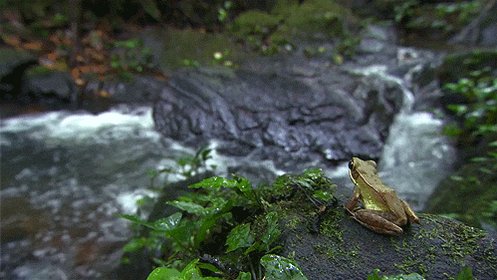
Recursive Leap of Faith

Slide 115
The Solution
void moveTower(int n, char from, char to, char temp) {
if (n == 1) {
moveSingleDisk(from, to);
} else {
moveTower(n – 1, from, temp, to);
moveSingleDisk(from, to);
moveTower(n – 1, temp, to, from);
}
}

Slide 116
Another Solution
void moveTower(int n, char from, char to, char temp) {
if (n == 0) {
return;
} else {
moveTower(n – 1, from, temp, to);
moveSingleDisk(from, to);
moveTower(n – 1, temp, to, from);
}
}

Slide 117
Even Simpler Solution
void moveTower(int n, char from, char to, char temp) {
if (n > 0) {
moveTower(n – 1, from, temp, to);
moveSingleDisk(from, to);
moveTower(n – 1, temp, to, from);
}
}

Slide 118


Slide 119
You can do recursion.

Slide 120

Your Brain is Recursive

Slide 121
There is a pathway in your brain for imagination

Slide 122
Step 1: Imagine a future at the end of CS106B

Slide 123
Step 1: Imagine a future at the end of CS106B

Slide 124
Step 2: Imagine a future after Stanford

Slide 125
Step 2: Imagine a future after Stanford
Executes the same “function” with different inputs

Slide 126
Step 2: Imagine a future after Stanford
Executes the same “function” with different inputs
Corballis, M.C. The Recursive Mind. Princeton University Press, 2011.

Slide 127
Today’s Goal
Be able to think about problems recursively

Slide 128
Three Musts of Recursion
Your code must have a case for all valid inputs.
You must have a base case.
When you make a recursive call it should be to a simpler instance (forward progress towards base case)

